Slide 1
How to merge bibliographic records in batch in a Network Zone institution
using the job Merge Records and Combine Inventory
Yoel Kortick
Senior Librarian

Slide 2
Agenda
Introduction
The current situation in the Network Zone consortium
Running the Merge Records and Combine Inventory job
The results of the Merge Records and Combine Inventory job
Another example
2

Slide 3
Introduction

Slide 4
Introduction
This presentation will focus specifically on running the “Merge Records and Combine Inventory job” in a Network Zone institution.
For full details on running the “Merge Records and Combine Inventory job” see separate presentation How to merge bibliographic records in batch using the job Merge and Combine Inventory.pptx
This current presentation will not repeat everything stated in How to merge bibliographic records in batch using the job Merge and Combine Inventory.pptx , but rather will focus on how this job works in a Network Zone institution.

Slide 5
The current situation in the Network Zone consortium

Slide 6
The current situation in the Network Zone consortium
Before we run the Merge Records and Combine Inventory job we need to run the Duplicate Title Analysis job.
This is because the output of the Duplicate Title Analysis job is used as input for the Merge Records and Combine Inventory job.

Slide 7
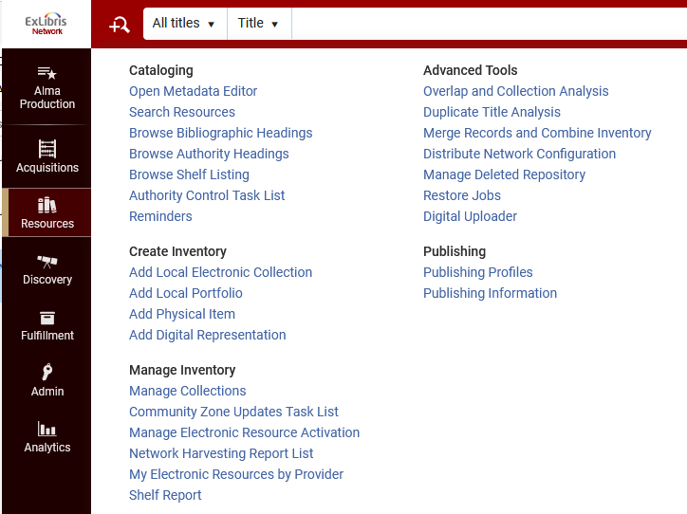
The current situation in the Network Zone consortium
The job Duplicate Title Analysis can be run from “Resources > Advanced Tools > Duplicate Title Analysis”
We are in the Network Zone

Slide 8
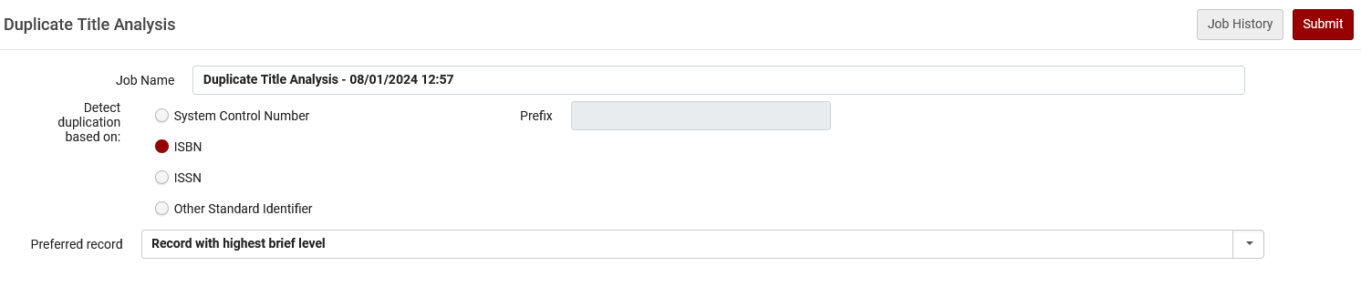
The current situation in the Network Zone consortium
Here we run the job Duplicate Title Analysis to match by ISBN and have the preferred record be the record with the highest brief level.

Slide 9
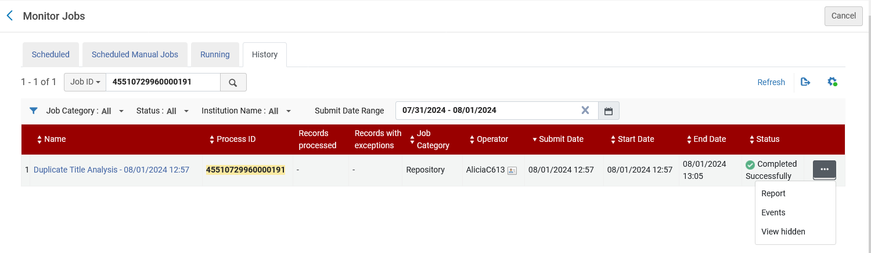
The current situation in the Network Zone consortium
From the “Monitor Jobs” “History” tab we will access the report of the job

Slide 10
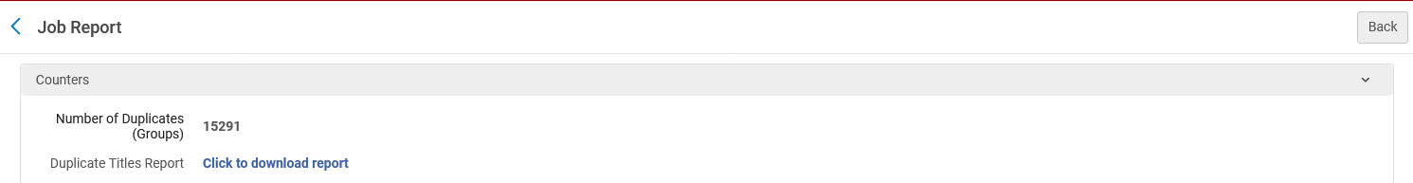
The current situation in the Network Zone consortium
From the report of the job, we download the results (which will later be used as input for the “Merge Records and Combine Inventory” job).
A .csv file is downloaded

Slide 11
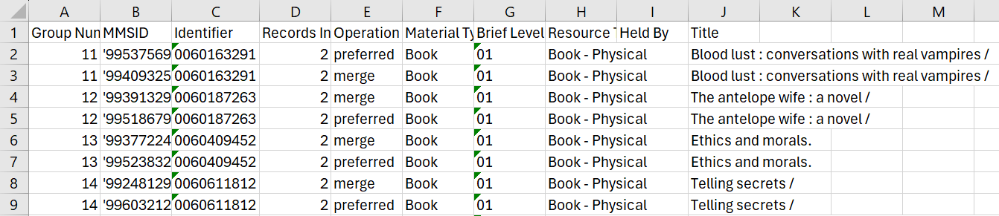
The current situation in the Network Zone consortium
Here is part of the results
These are the “Groups” to which we previously referred
Let’s look for example at ISBN 0060163291, title “Blood lust : conversations with real vampires”

Slide 12
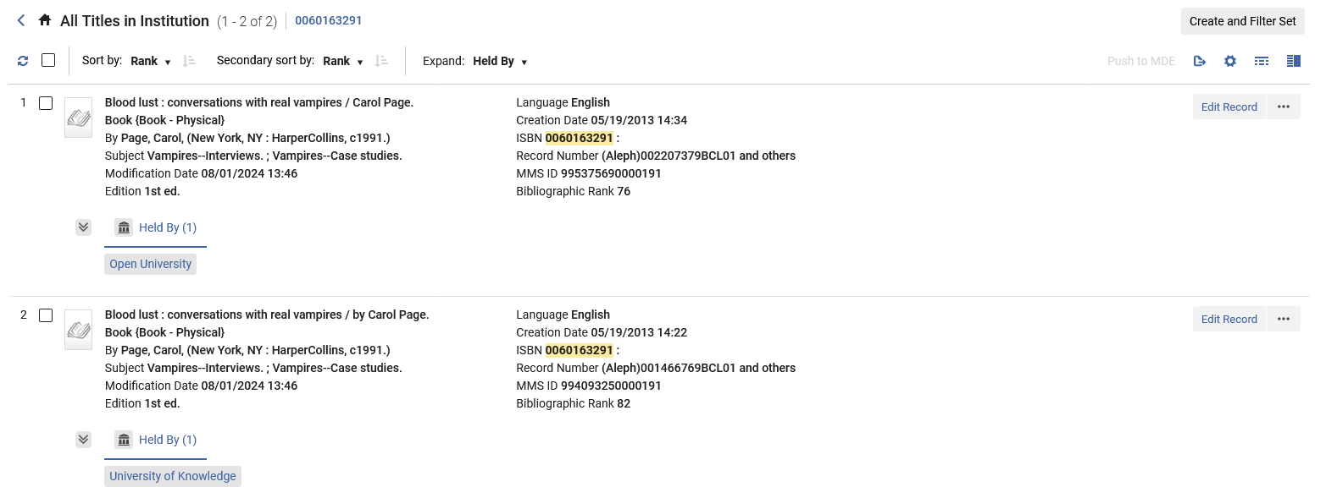
The current situation in the Network Zone consortium
We see two bibliographic records, both of which are Held By a member institution
The preferred record, MMSID 995375690000191, is Held By member institution Open University
The secondary record, MMSID 994093250000191, is Held By member institution University of Knowledge

Slide 13
The current situation in the Network Zone consortium
For testing purposes, we have modified the output of the Duplicate Title Analysis job and put only the one group with ISBN 0060163291 (Title “Blood lust : conversations with real vampires”).
This way we can run and test the “Merge and Combine Inventory” on this specific record only and check the result.
We will now use this file with one group as input for the job “Merge and Combine Inventory”

Slide 14
Running the Merge Records and Combine Inventory job

Slide 15
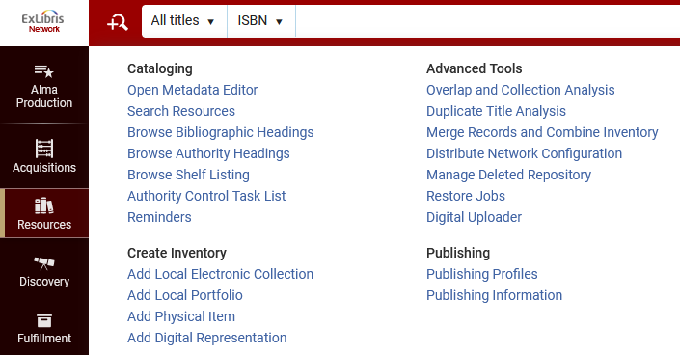
Running the Merge Records and Combine Inventory job
The job “Merge Records and Combine Inventory” can be run from “Resources > Advanced Tools > Merge Records and Combine Inventory ”
We are in the Network Zone

Slide 16
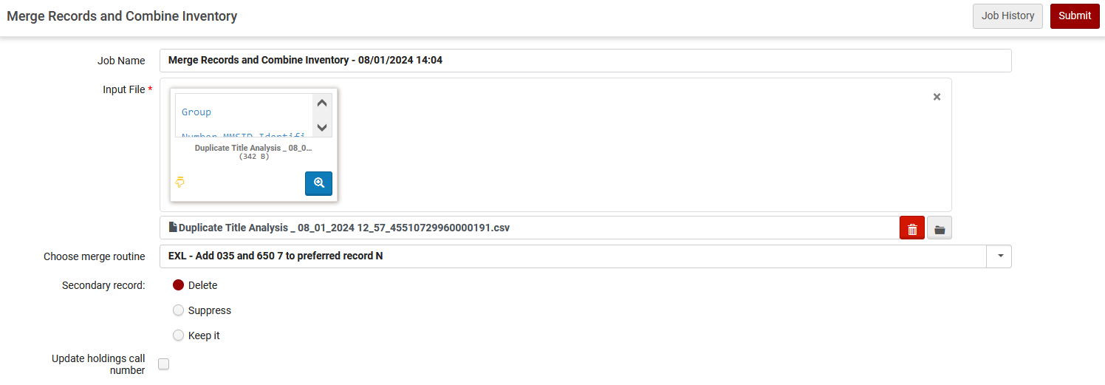
Running the Merge Records and Combine Inventory job
Here we run the job.
We will leave the default job name which is “Merge Records and Combine Inventory – {date and time}
This is the input file with one group which we made from the output of the job Duplicate Title Analysis
This is the chosen merge routine
We will delete the secondary record

Slide 17
The results of the Merge Records and Combine Inventory job

Slide 18
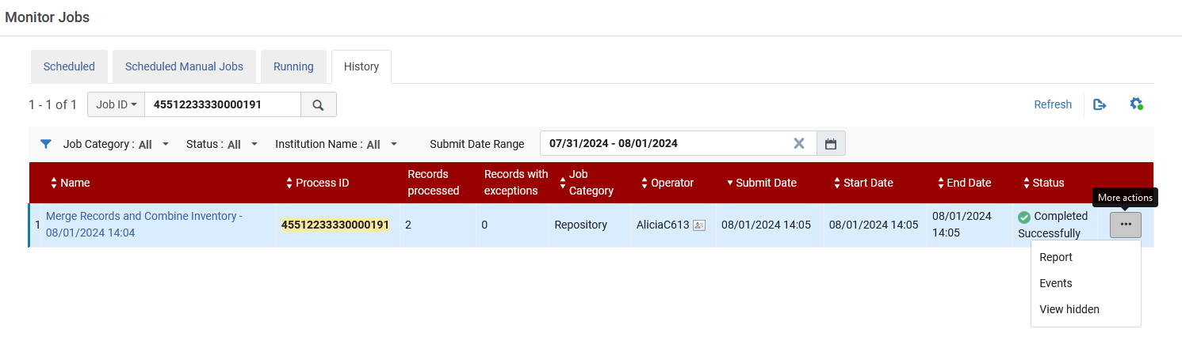
The results of the Merge Records and Combine Inventory job
The job completes and we check the report

Slide 19
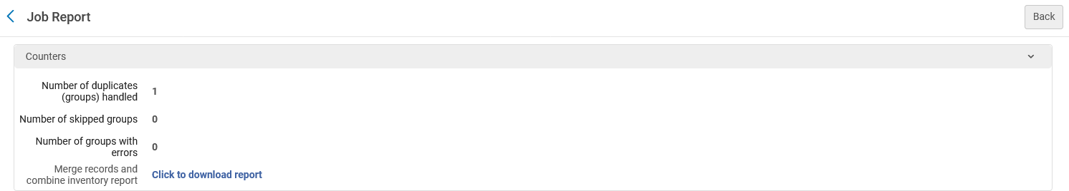
The results of the Merge Records and Combine Inventory job
We will download the report
One group was handled because we had only one group in the input file.

Slide 20
The results of the Merge Records and Combine Inventory job
Columns A – I state which records were handled in the Merge records and Combine Inventory job.

Slide 21
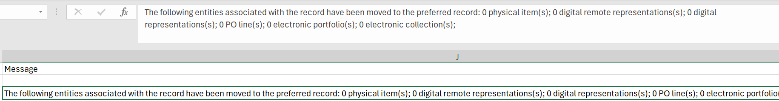
The results of the Merge Records and Combine Inventory job
Columns J states which entities have been moved to the preferred record

Slide 22
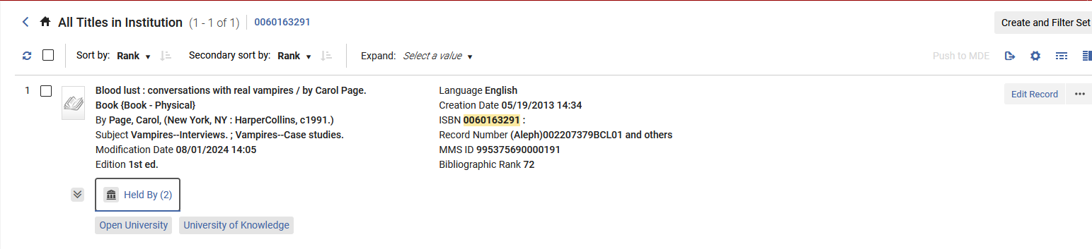
The results of the Merge Records and Combine Inventory job
Now ISBN 0007256523 has only one record (previously it had two).
The one record is Held By both member institutions. The job worked successfully.
Previously there were two bibliographic records each ‘Held By” a different institution.
The preferred record, MMSID 995375690000191, was Held By member institution Open University
The secondary record, MMSID 994093250000191, was Held By member institution University of Knowledge
Now only the preferred record exists (MMSID 995375690000191) and it is held by both member institutions.

Slide 23
Another example

Slide 24
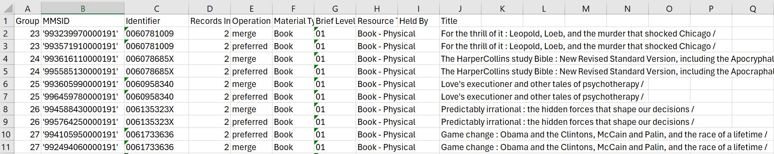
Another example
Here is part of the results of the job “Duplicate Title Analysis” run in the Network Zone
These are the “Groups” to which we previously referred
Let’s look for example at ISBN 0060958340, title “Love's executioner and other tales of psychotherapy”

Slide 25
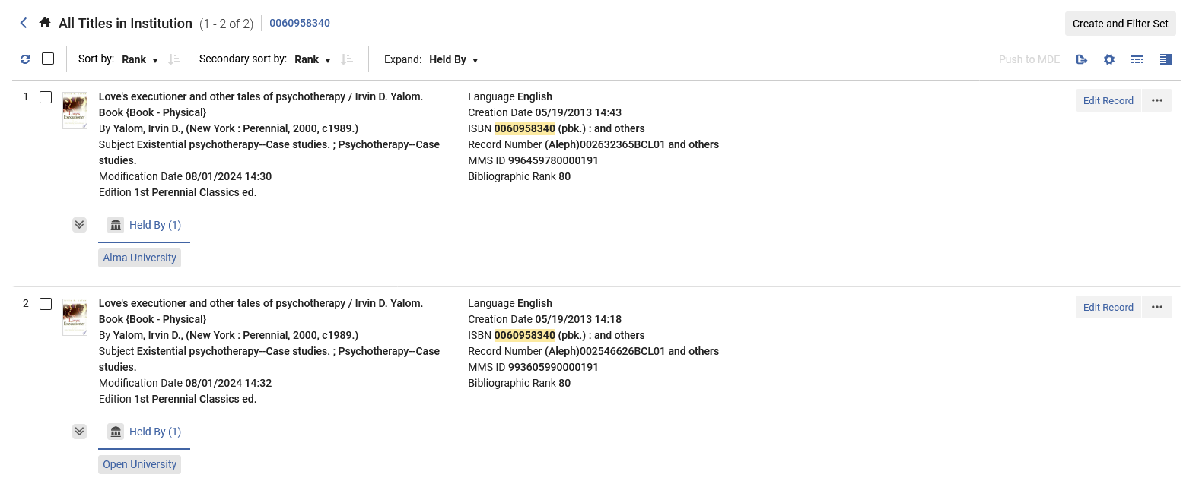
Another example
We see two bibliographic records, both of which are Held By a member institution
The preferred record, MMSID 996459780000191, is Held By member institution Alma University
The secondary record, MMSID 993605990000191, is Held By member institution Open University

Slide 26
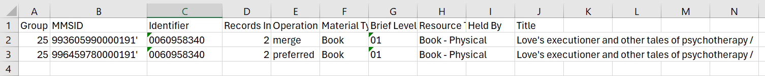
Another example
For testing purposes, we have modified the output of the Duplicate Title Analysis job and put only the one group with ISBN 0060958340 (Title “Love's executioner and other tales of psychotherapy”).
This way we can run and test the “Merge and Combine Inventory” on this specific record only and check the result.
We will now use this file with one group as input for the job “Merge and Combine Inventory”

Slide 27
Another example
The job “Merge Records and Combine Inventory” can be run from “Resources > Advanced Tools > Merge Records and Combine Inventory ”
We are in the Network Zone

Slide 28
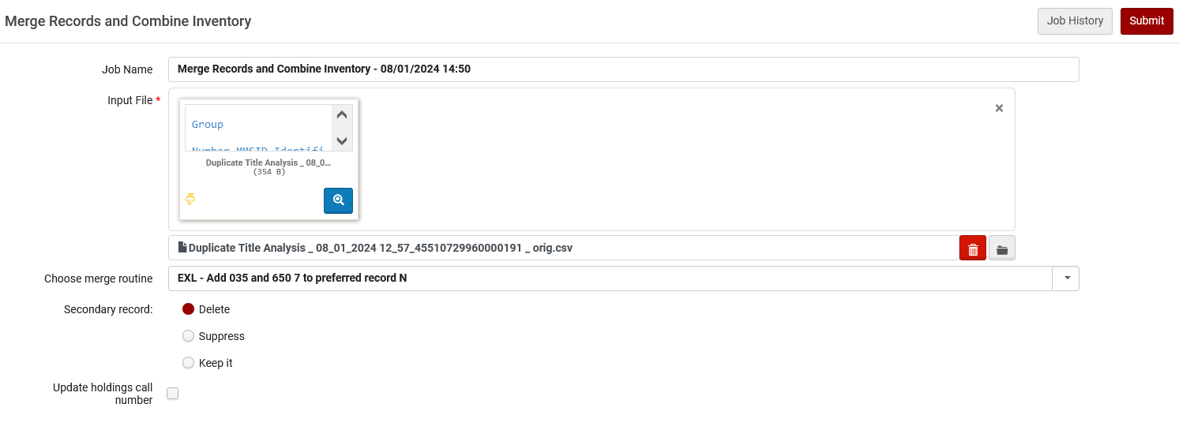
Another example
Here we run the job.
We will leave the default job name which is “Merge Records and Combine Inventory – {date and time}
This is the input file with one group which we made from the output of the job Duplicate Title Analysis
This is the chosen merge routine
We will delete the secondary record

Slide 29
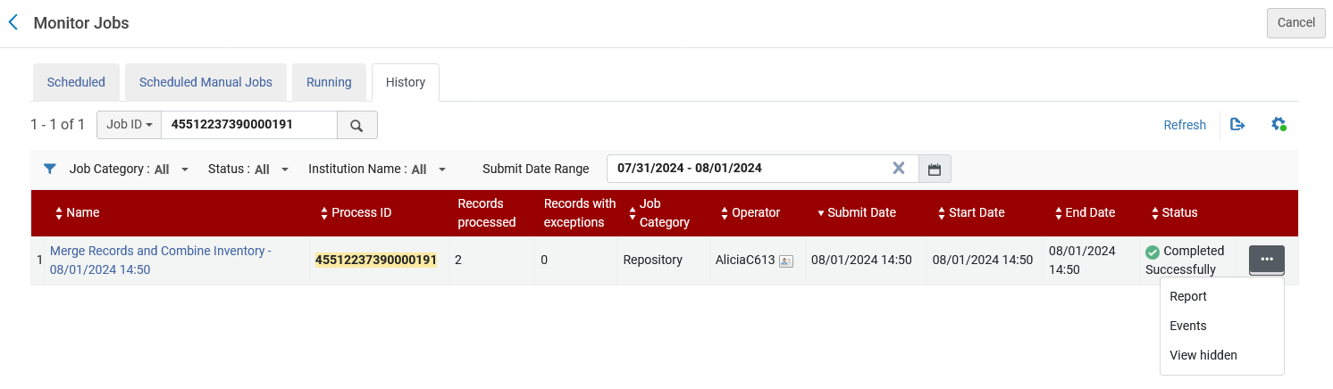
Another example
The job completes and we check the report

Slide 30
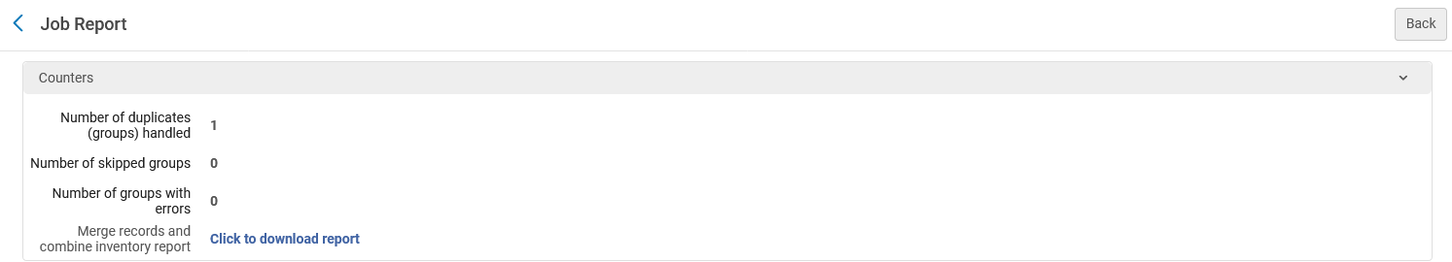
Another example
We will download the report
One group was handled because we had only one group in the input file.

Slide 31
Another example
Columns A – I state which records were handled in the Merge records and Combine Inventory job.

Slide 32
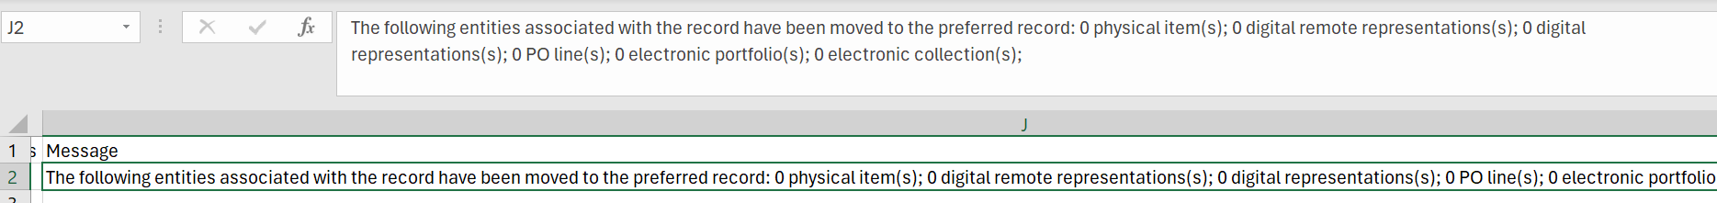
Another example
Columns J states which entities have been moved to the preferred record

Slide 33
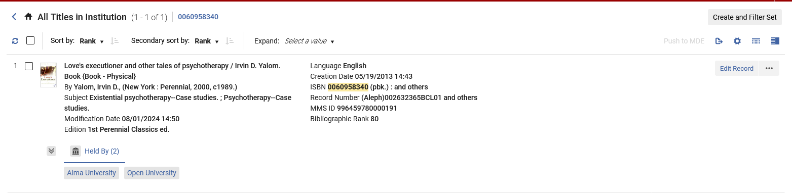
Another example
Now ISBN 0060958340 has only one record (previously it had two).
The one record is Held By both member institutions. The job worked successfully.
Previously there were two bibliographic records each ‘Held By” a different institution.
The preferred record, MMSID 996459780000191, was Held By member institution Alma University
The secondary record, MMSID 993605990000191, was Held By member institution Open University
Now only the preferred record exists (MMSID 996459780000191) and it is held by both member institutions.

Slide 34
Thank You

